Slide 1

Geography Pack
Make the most of maps!

Slide 2

This year, we purchased online access to a computer program called Digimap for Schools, which allows us to see and use maps from around the world. Some classes have already been using it.
In this pack, we have put together some suggestions about how you might like to use this package at home. We hope you enjoy using it!

Slide 3
How to log in
Click on the link below to open up the Digimap for Schools software.
Digimap for Schools program
Type in our school’s username and password, which is:
username: NR93EQ
password: blergs3511

Slide 4
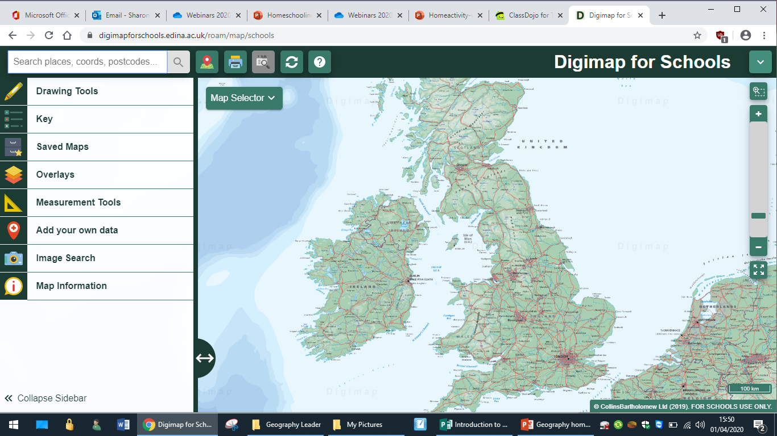
Task 1 – Find your house!
Type your postcode in here!

Slide 5
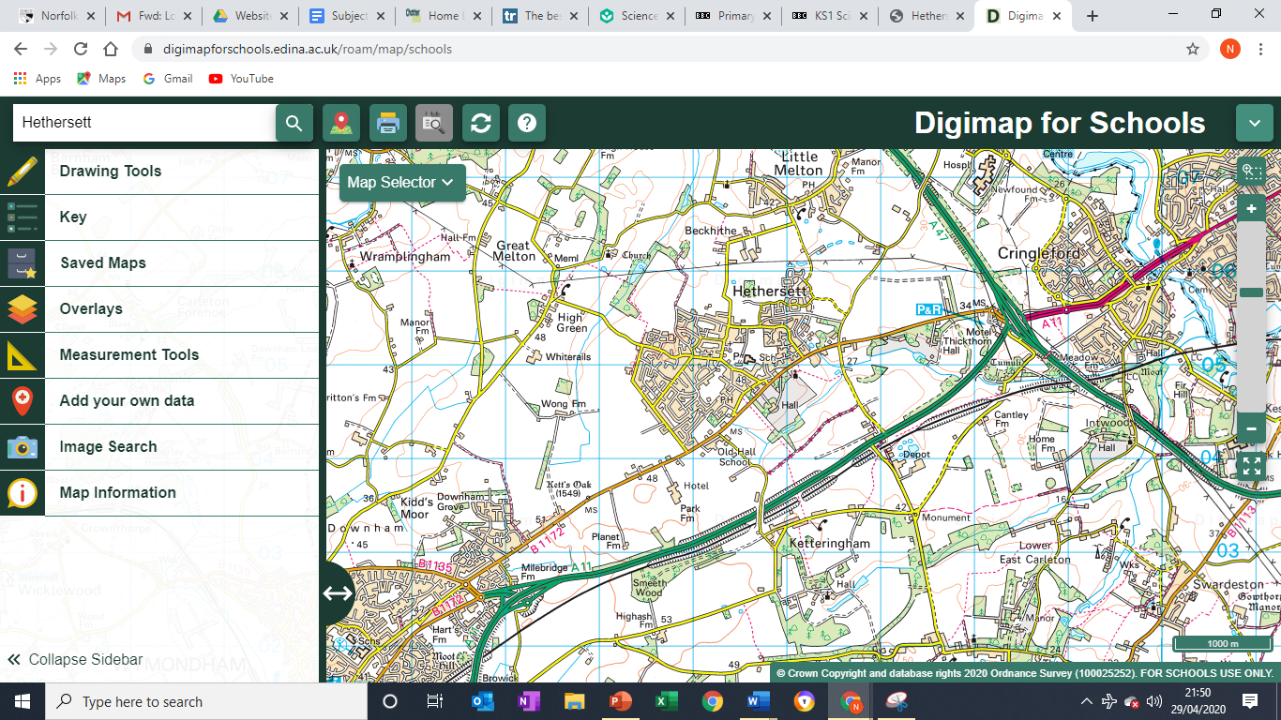
Task 1 – Find your house!
Use this slider bar to zoom in and out. Use the drawing tools to drop a pin on places you know.

Slide 6
Task 1 – Find your house!
Use the “Map Selector” bar to change the view. You can slide between the modern map and other views using the slider above where it says Ordnance Survey.
Was your house there in 1890?
Was your house there in 1950?
What does your house look like from above?

Slide 7
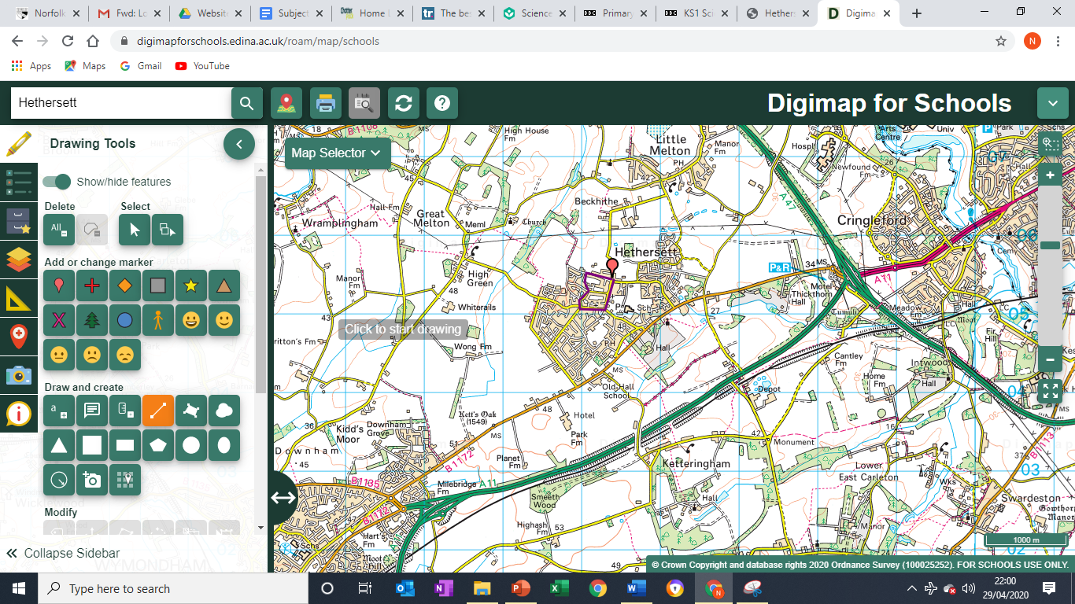
Task 2 – Plan a walk!
1. Click on drawing tools
2. Choose the straight line drawing tool. Scroll down if you want to change the colour of your line.
3. Draw a line to show where you want to walk. Click your mouse when you want to change direction. Do a double click when you have finished.

Slide 8
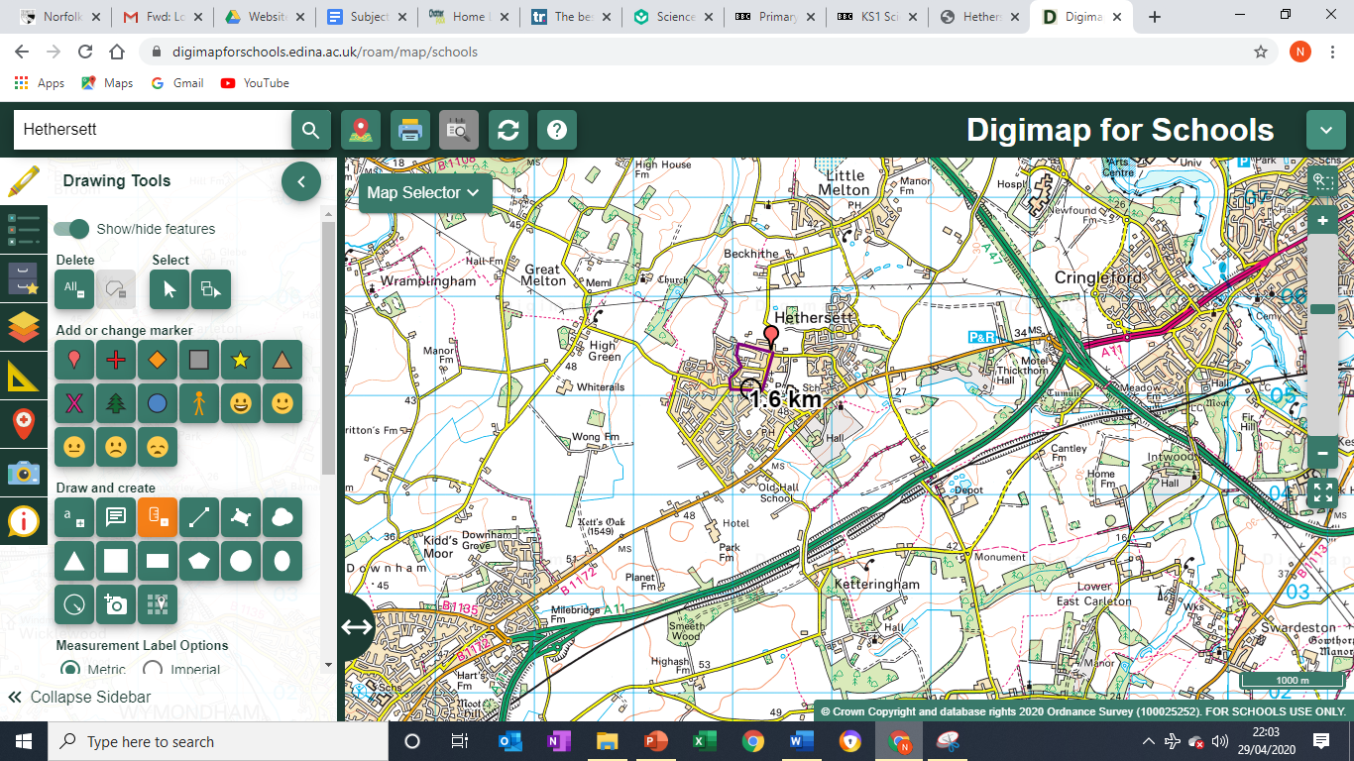
Task 3 – Measure the distance of your walk!
1. Choose measurement Tools
2. Click on the route you have drawn and it will tell you how long it is!

Slide 9
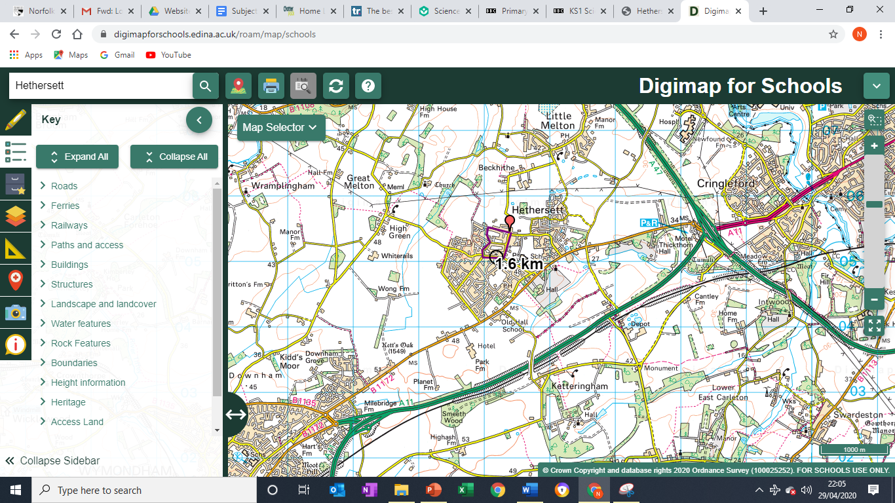
Task 4 – Use the key to find out what you might see on your walk!
Click on the key tab.
The key is split up into different features.

Slide 10
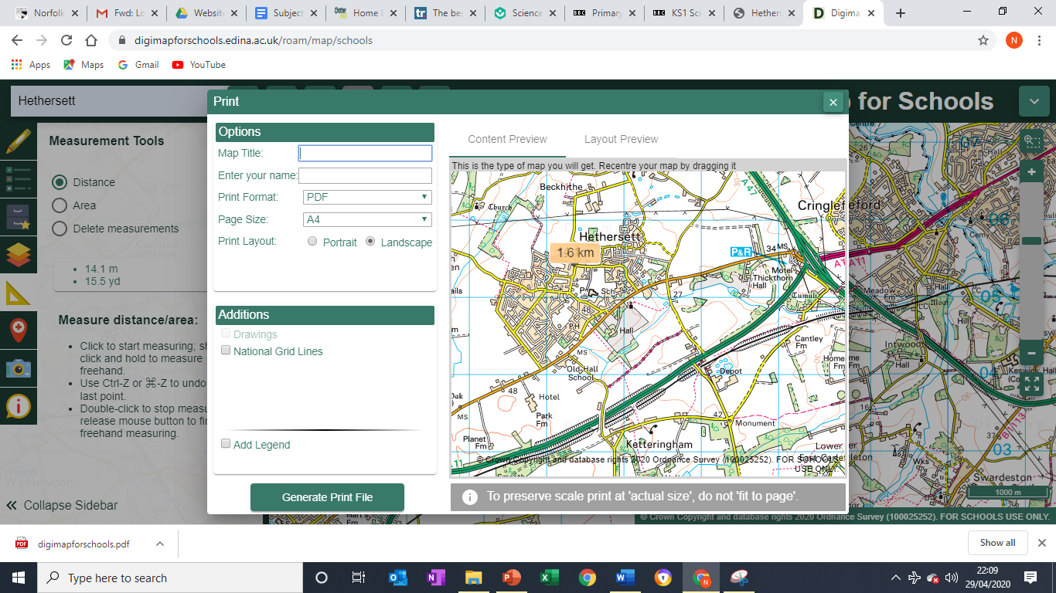
Task 5 - Now go on your walk!
If you would like to print your map out, follow these instructions.
Time yourself on your walk and work out how long it takes you to walk 1km!
I don’t recommend saving your map as it is accessible to anyone else who has our school log in details. This gives people information about where you live. Think about safety!
Click on the printer. Follow the instructions. The program will make a pdf of your map.

Slide 11
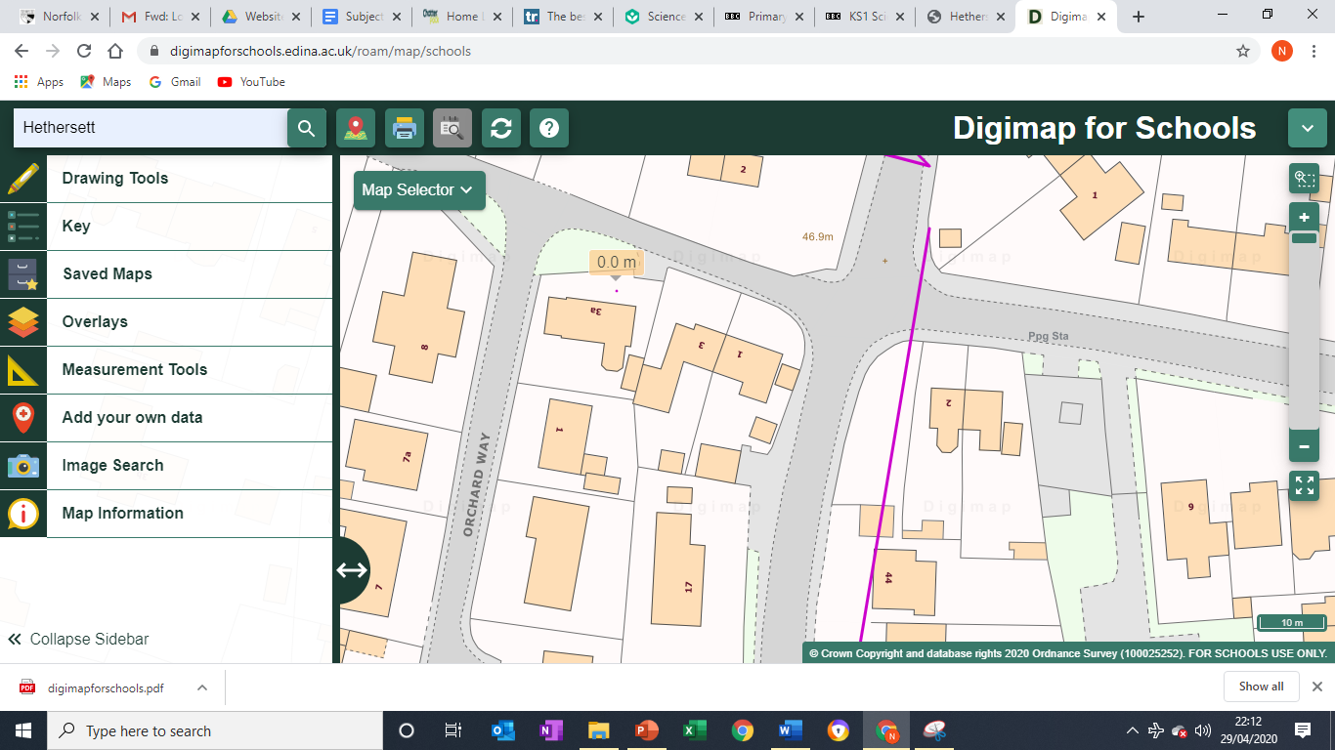
Task 6 – Take a look at your garden (or the area right next to where you live) and make a photo map
Take lots of photos of things that are in your garden and save them on your computer.
Double click on a spot to zoom in so you can see lots of details around the place where you live.

